Slide 1
COVID 19 Live Dashboard
SIDDHARTHA BORGOHAIN

Slide 2

Data Collected from WHO.INT
CSV LINK: https://covid19.who.int/WHO-COVID-19-global-data.csv
Notes:
This is the question that your experiment answers

Slide 3
Project Over view
COVID 19 pandemic is one of the most disastrous situation we have ever experience after WORLD WAR TWO. The outbreak of corona virus disease 2019 has created a global health crisis and it takes many life's . This disease is caused by the SARS-CoV-2 virus.
From the data collected by WHO and several organizations I have created a live dashboard using tableau and planning to do the same on Power BI and python , Which represent statistical models to describe the present situation od cases and deaths reported on daily basis

Slide 4
WHO_region
WHO regional offices: WHO Member States are grouped into six WHO regions -- Regional Office for Africa (AFRO), Regional Office for the Americas (AMRO), Regional Office for South-East Asia (SEARO), Regional Office for Europe (EURO), Regional Office for the Eastern Mediterranean (EMRO), and Regional Office for the Western Pacific (WPRO).

Slide 5
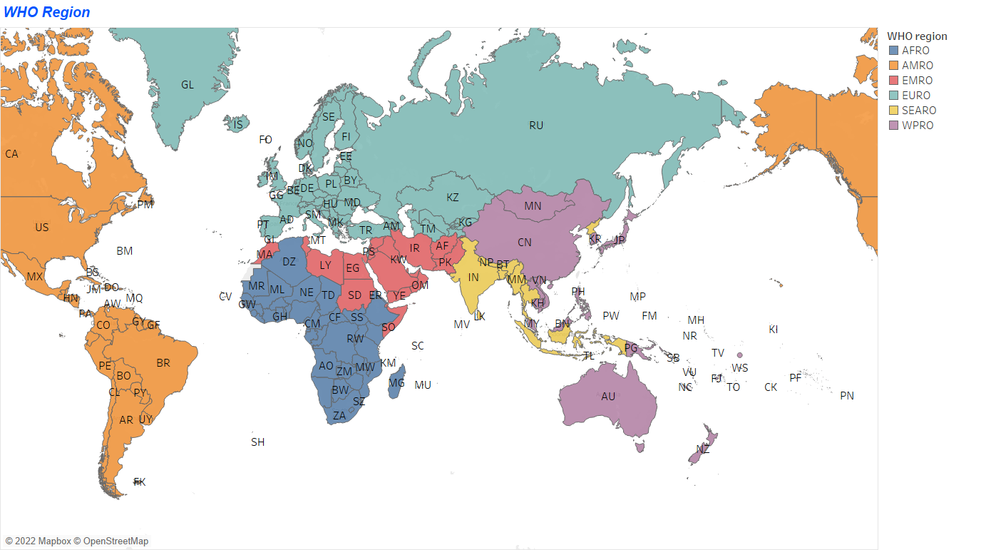
Notes:
Establish hypothesis before you begin the experiment. This should be your best educated guess based on your research.

Slide 6
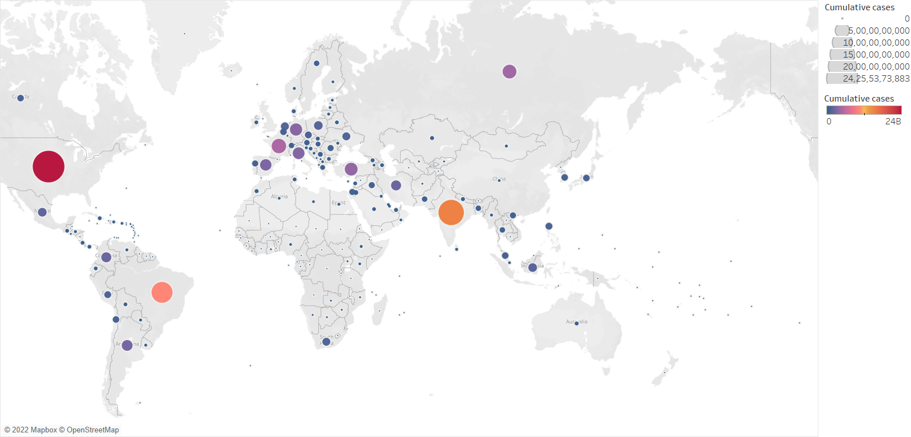
Confirmed Cases reported to WHO

Slide 7
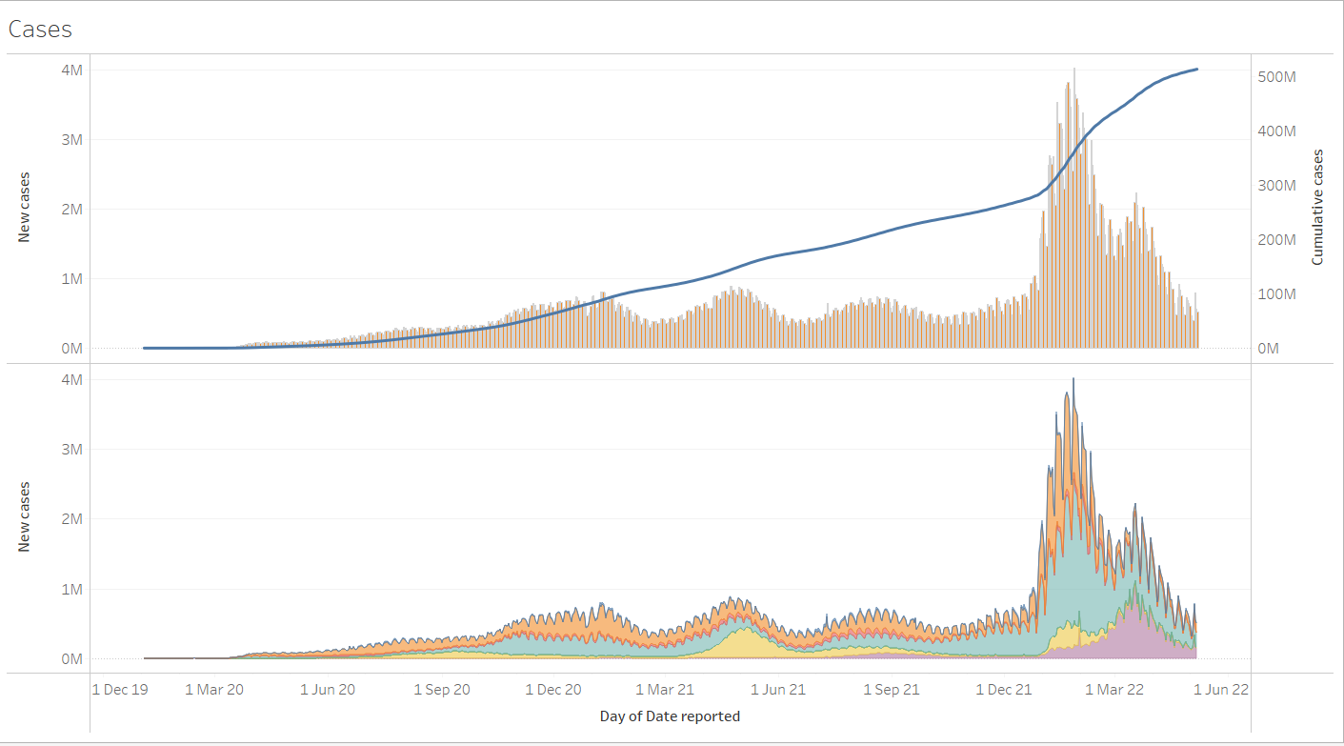
cumulative and new Cases

Slide 8
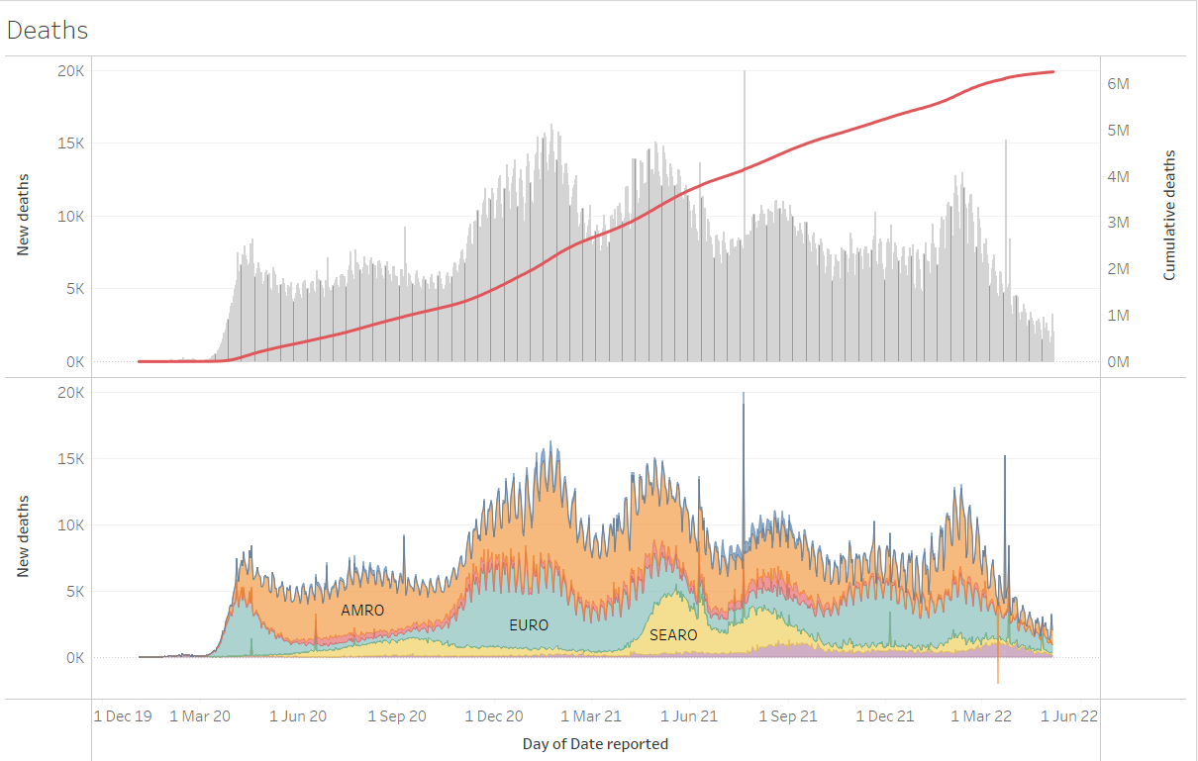
cumulative and new Deaths

Slide 9
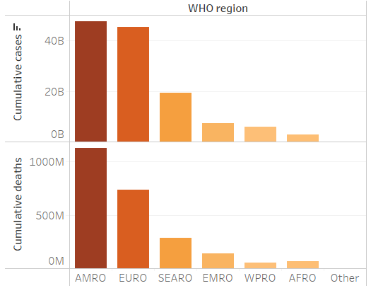
Global Cases and deaths by Region
Notes:
Establish hypothesis before you begin the experiment. This should be your best educated guess based on your research.

Slide 10
Conclusion
From the following graphs we can conclude that USA reports the most COVID-19 cases followed by India and Brazil
European Continent tops the cases combining all there nations
From march 2022 there is a decreasing trend of daily cases and death reports
Cumulative reports have no drastic change from three months
First Quarter of 2021 reports highest deaths and First Quarter of 2022 reports highest cases

Slide 11
THANK
YOU

